Slide 1
High Availability & Scalability For EC2 (ALB AND ASG)
Presented by: Chinwuba Chidubem

Slide 2
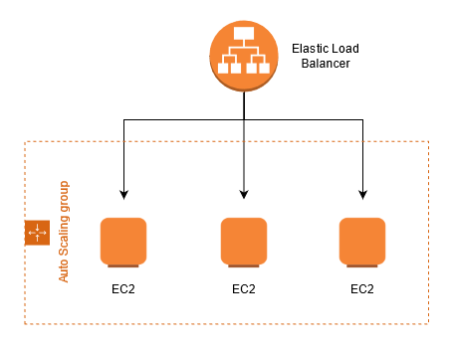
ARCHITECTURE

Slide 3
OUTLINE
Create autoscaling group
Attach to an existing load balancer
Create dynamic scaling policies
Connect to instance
Initiate stress testing
Monitor CPU utilization

Slide 4
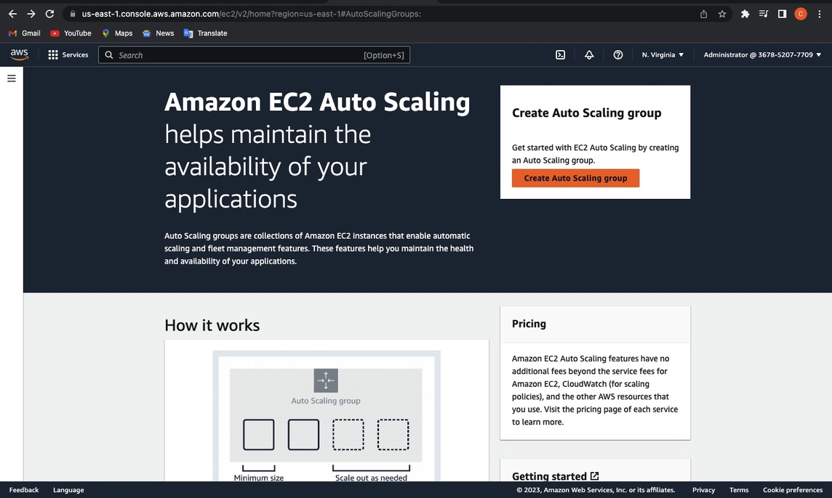
CREATE AUTOSCALING GROUP

Slide 5
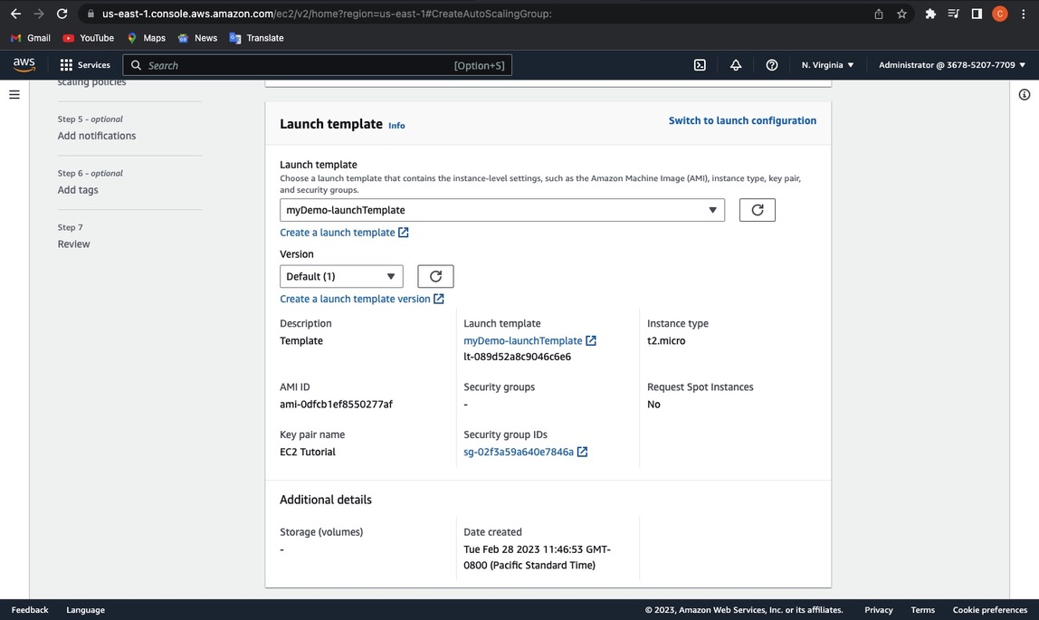
CREATE LAUNCH TEMPLATE

Slide 6
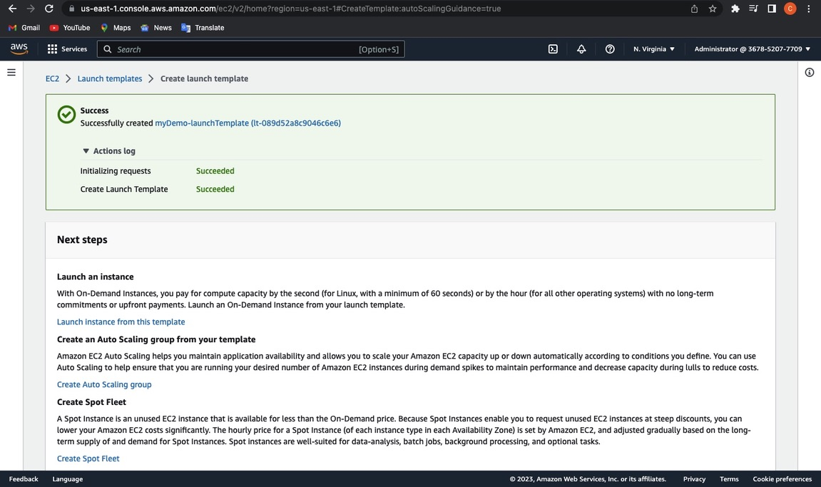

Slide 7
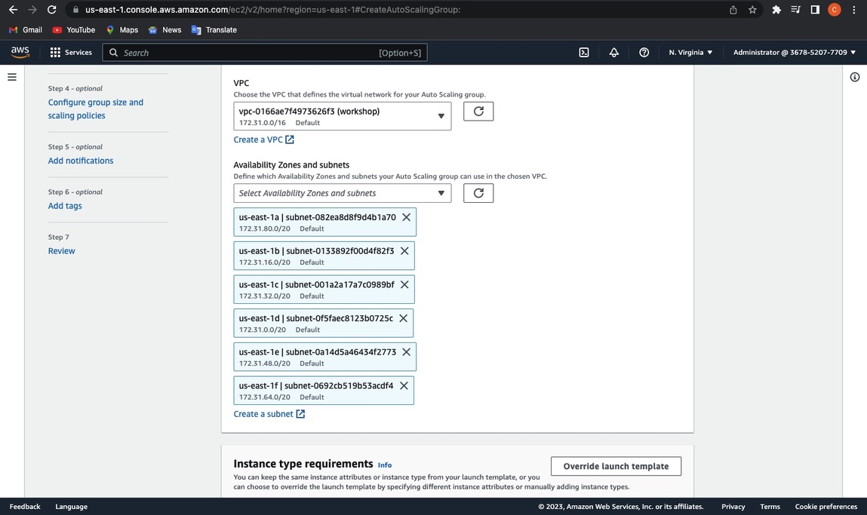

Slide 8
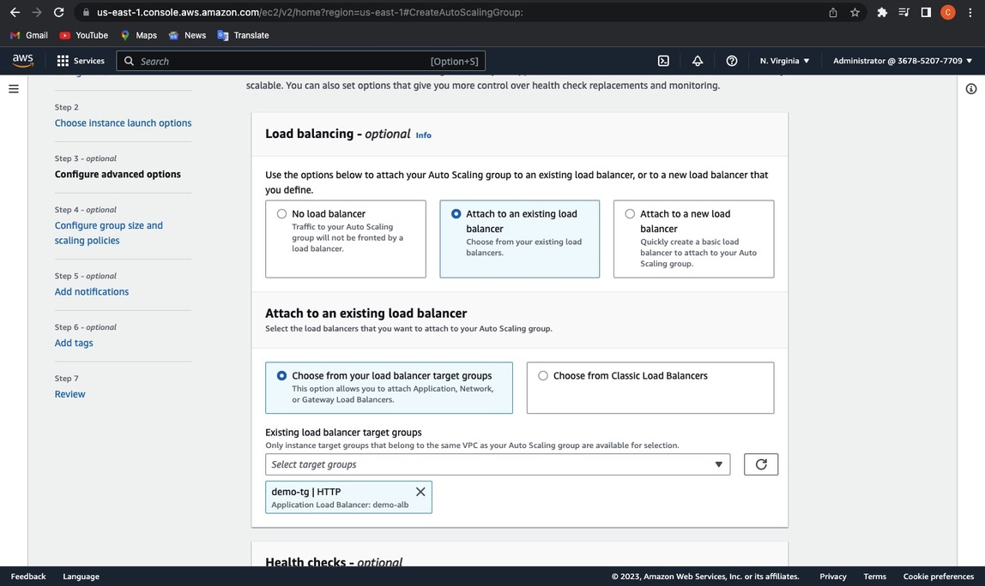

Slide 9
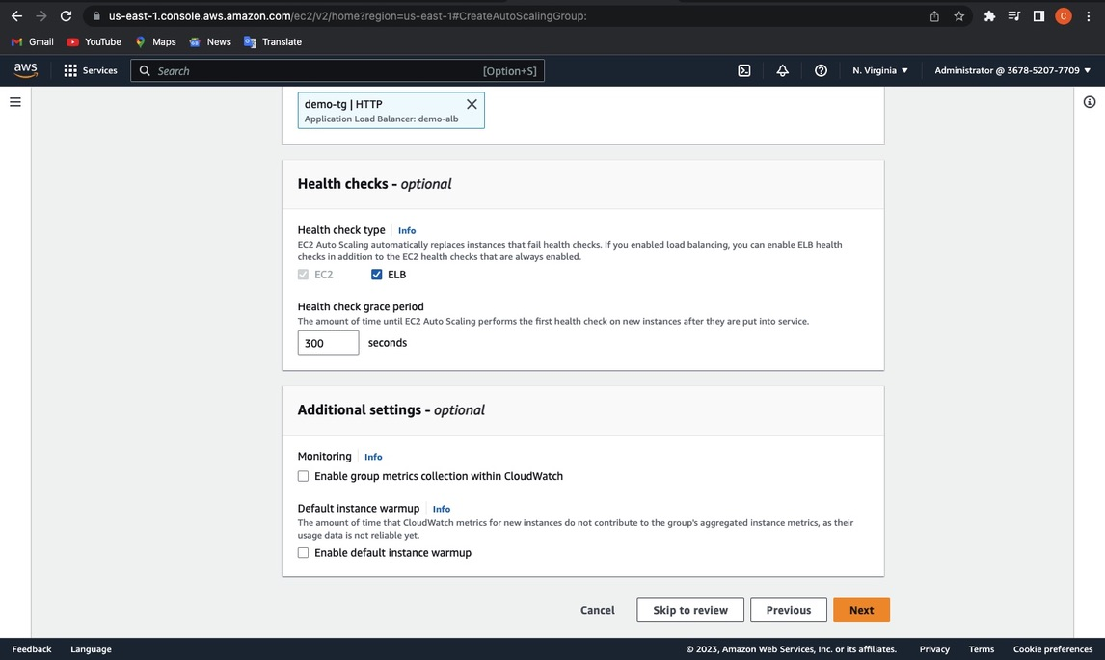

Slide 10
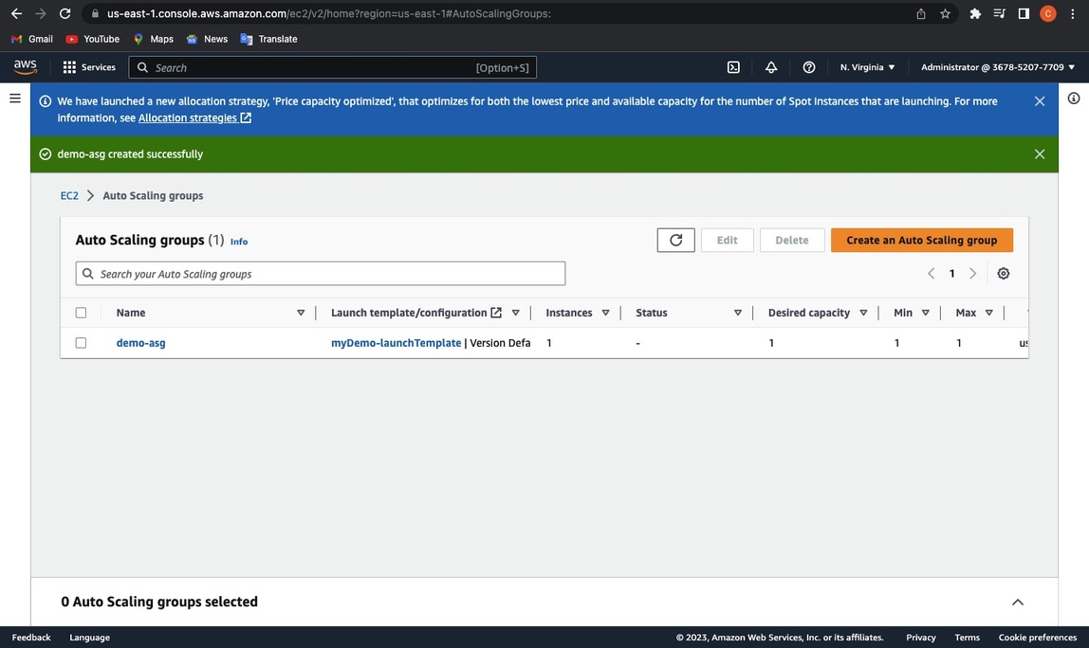

Slide 11
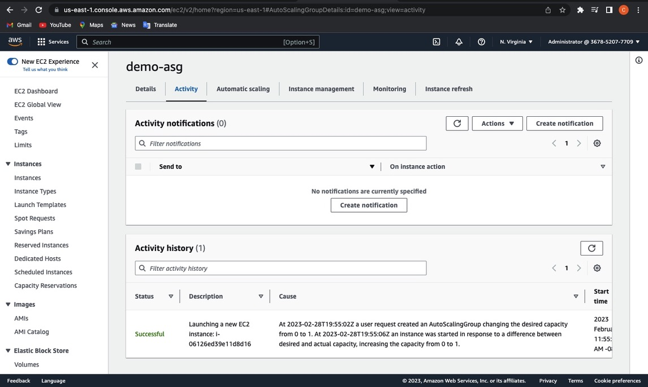

Slide 12
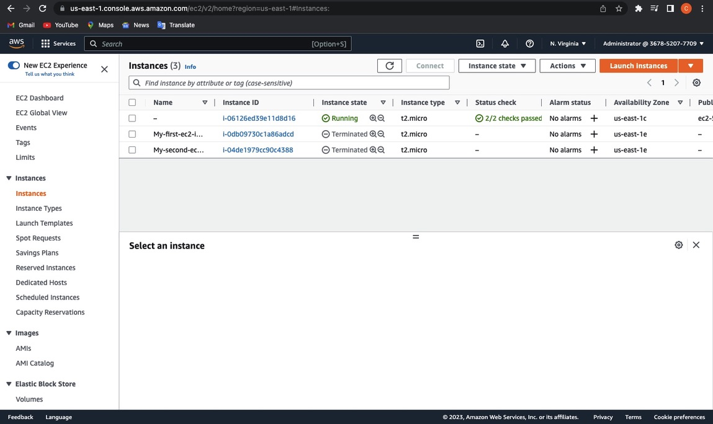

Slide 13
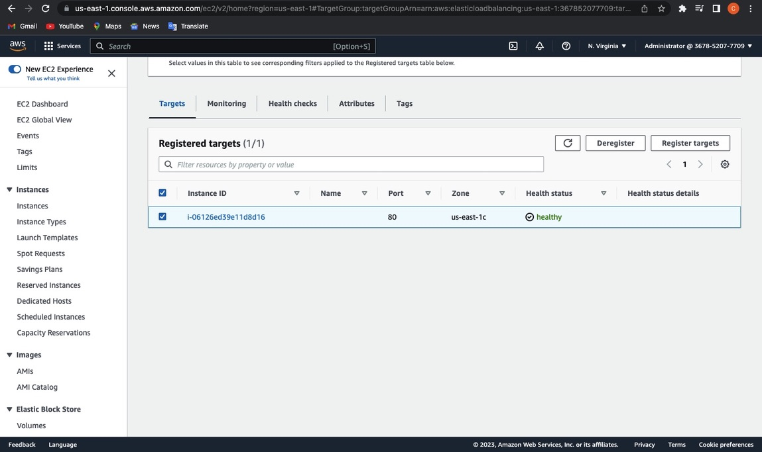

Slide 14


Slide 15
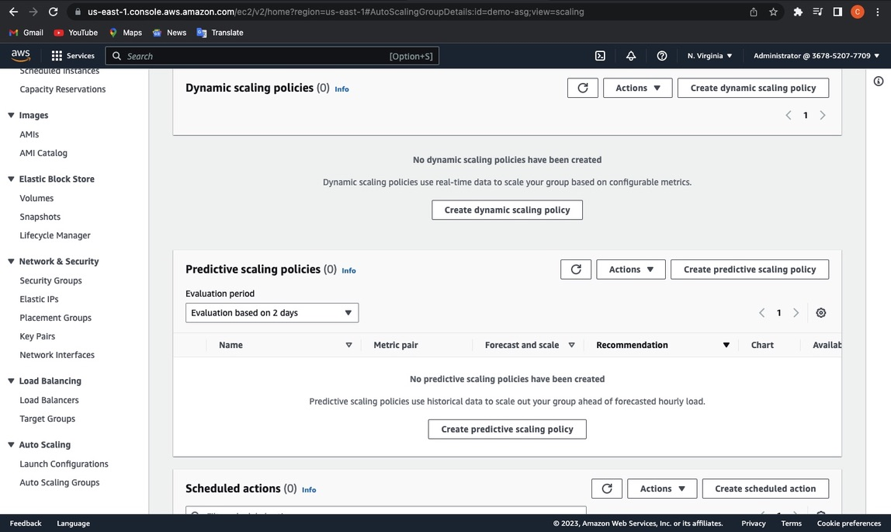
CREATE DYNAMIC SCALING POLICY

Slide 16
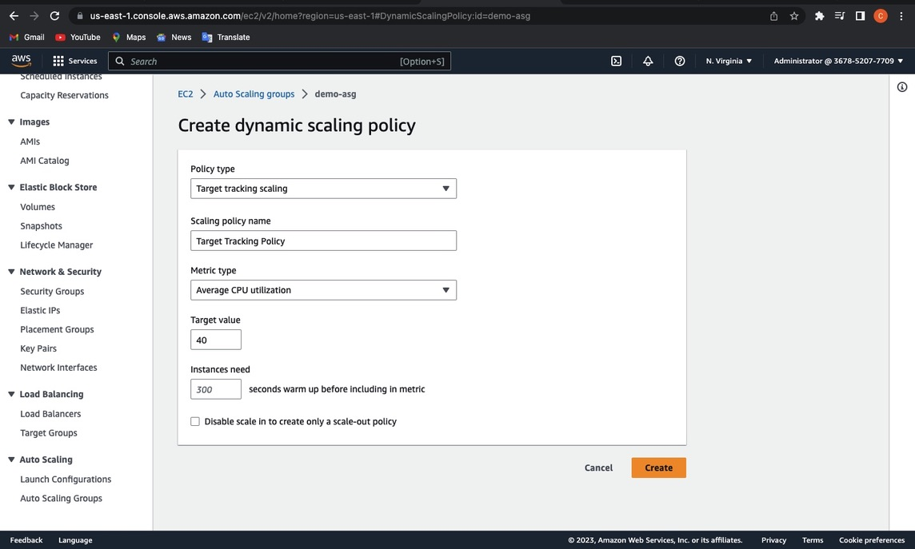

Slide 17
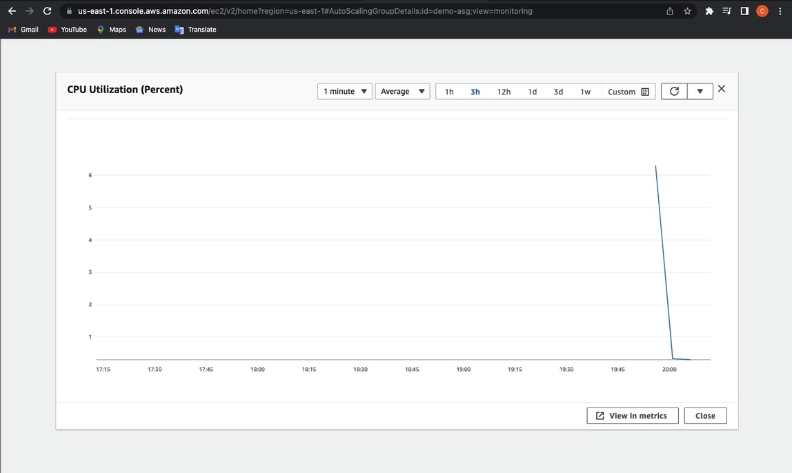
CPU UTILIZATION BEFORE STRESS TESTING

Slide 18
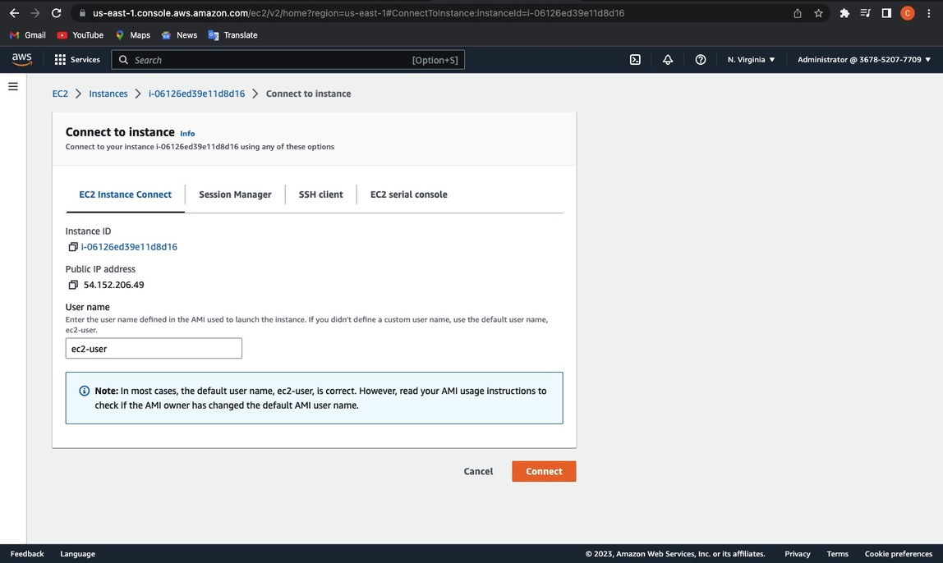

Slide 19
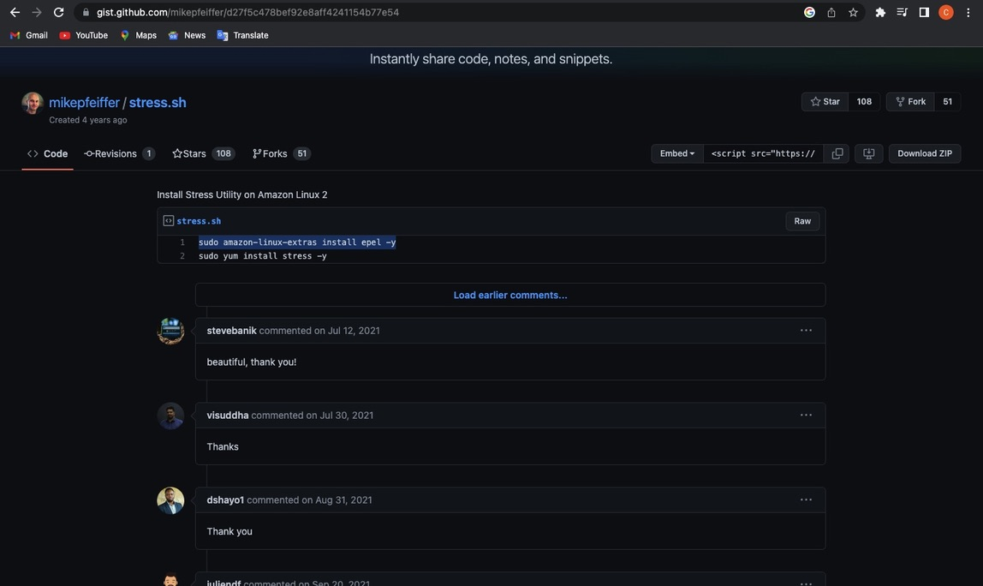
STRESS TESTING

Slide 20
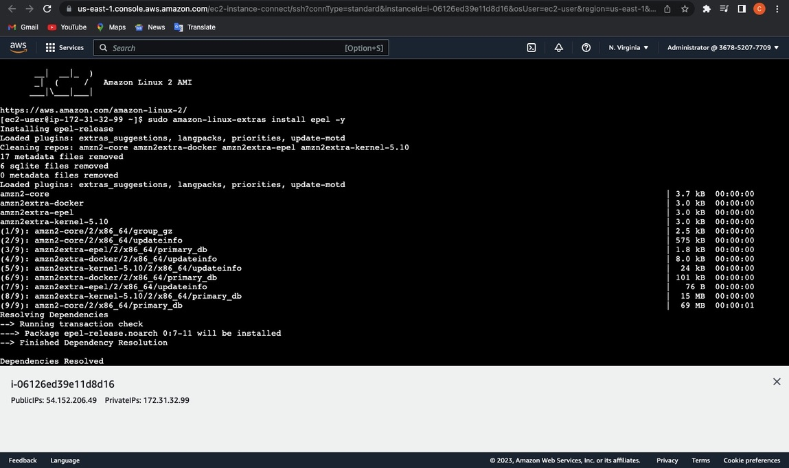

Slide 21
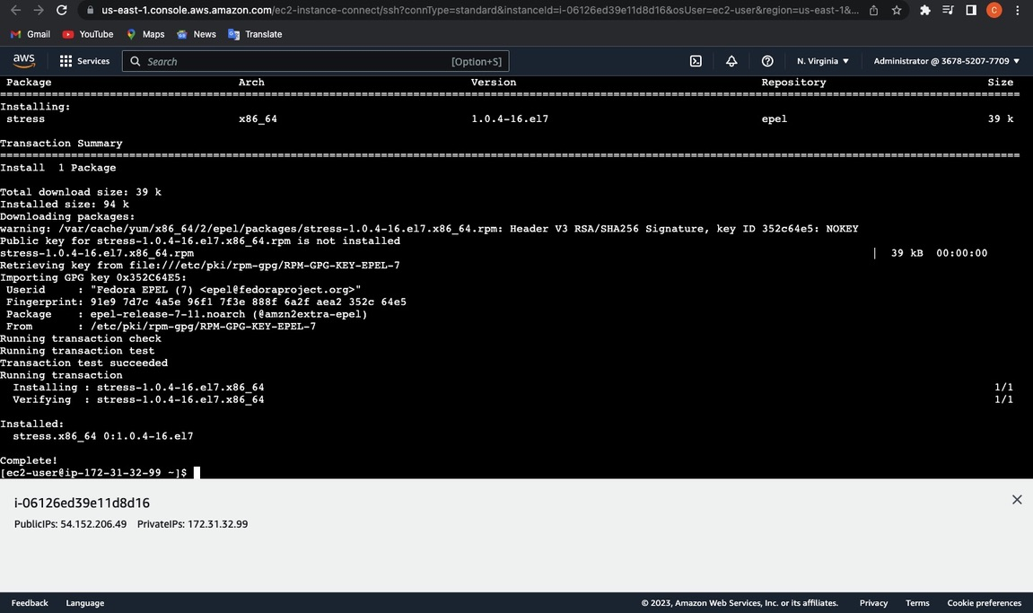

Slide 22
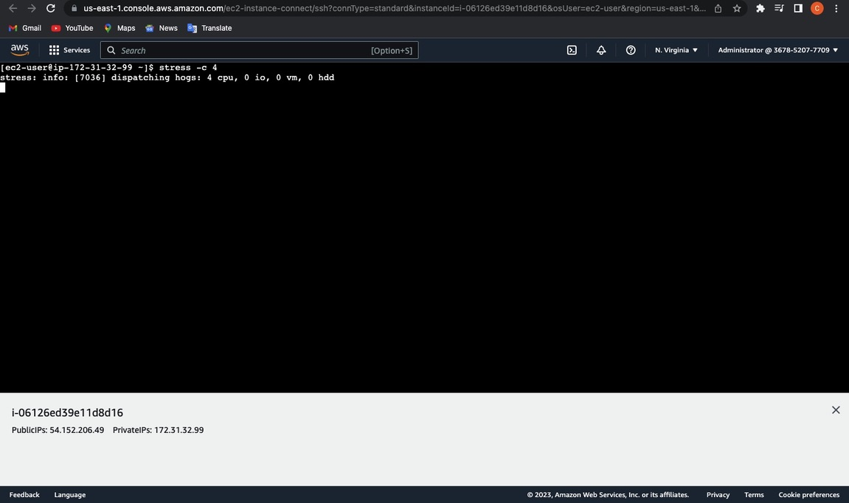

Slide 23
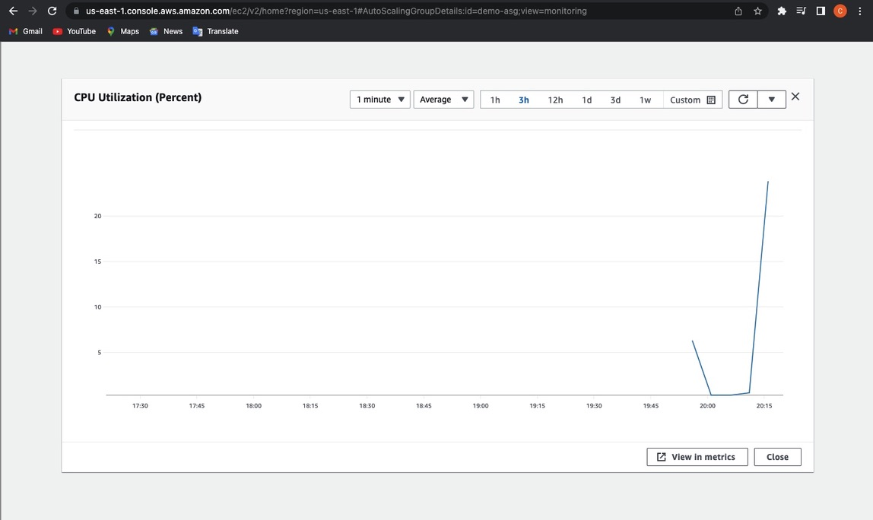
CPU UTILIZATION DURING STRESS TESTING

Slide 24
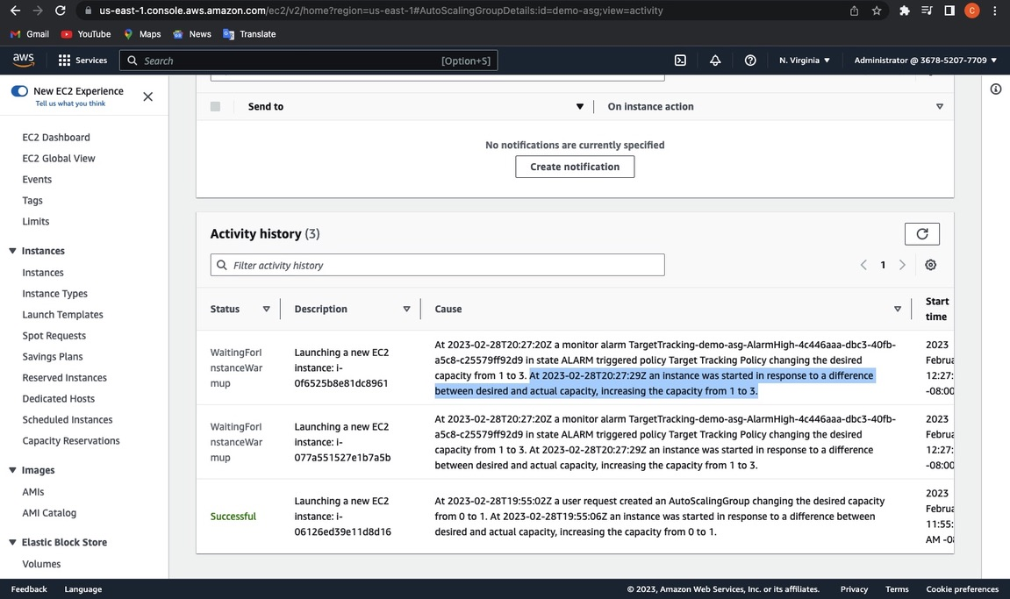

Slide 25
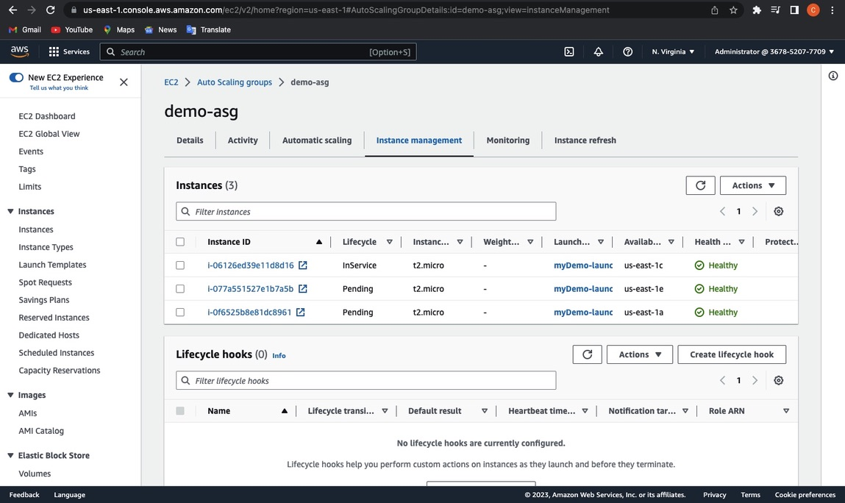

Slide 26
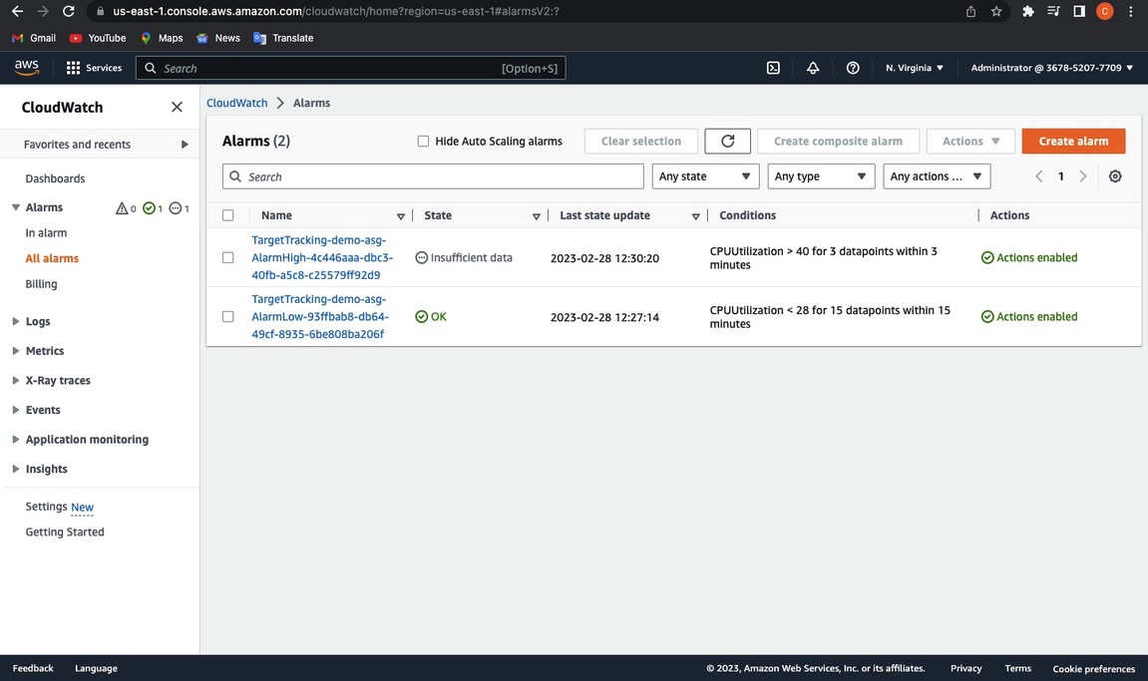

Slide 27
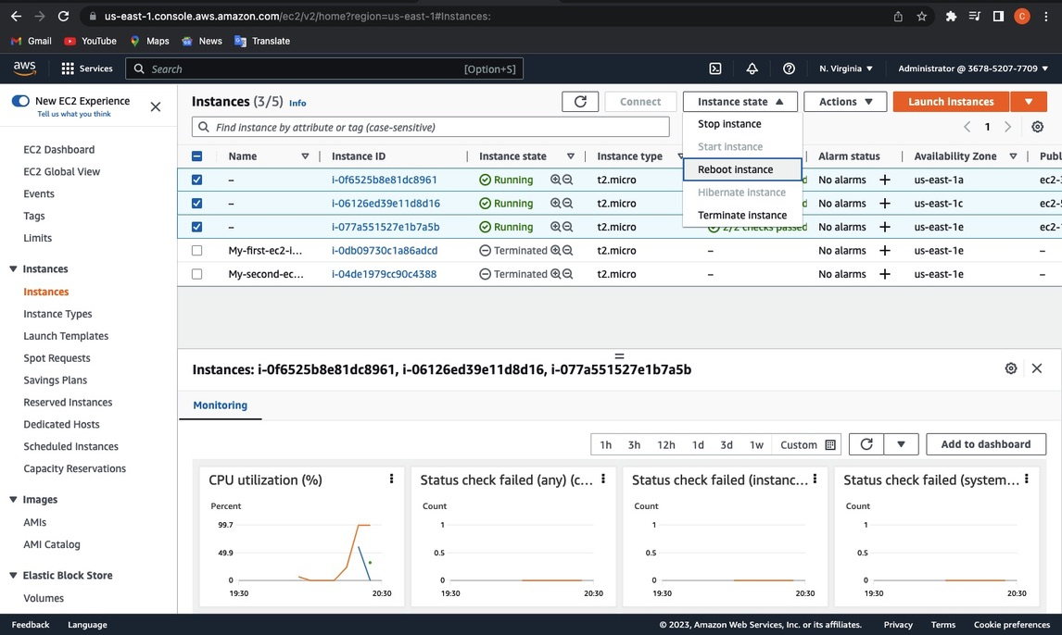
TERMINATE STRESS TESTING

Slide 28
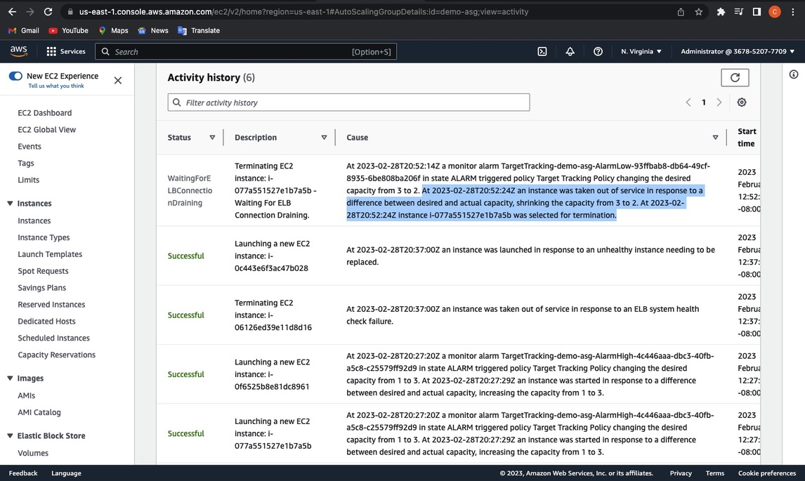

Slide 29
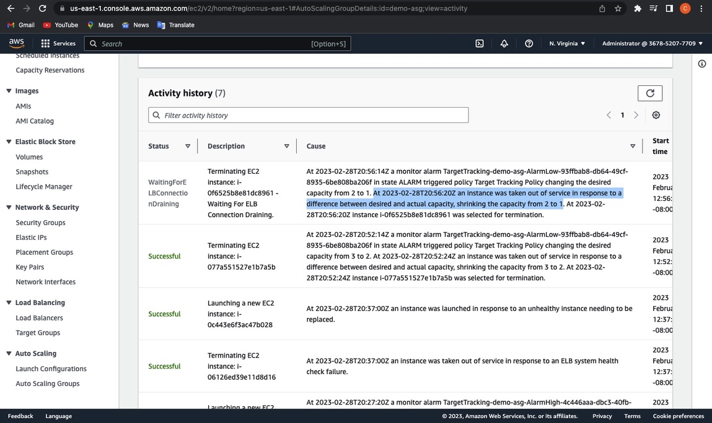

Slide 30
